Slide 1

Human resources analysis
AdventureWorks HR Department
Marina Mikhailova/Data Analyst

Slide 2
Tasks for the analysis
In the 8 years of company’s functioning :
How is our company’s headcount growing and what is the attrition rate
What is gender ratio in the company/departments
What are our employees’ age groups
Do we need to make any changes in our employee/shift planning
What are our rates for pay and how are they matching the principle of gender equality
Do we need to fill in any position

Slide 3
Main KPIs
Number of Employees – 290
Departments – 16
Cities – 31
Average Age – 36
Attrition – 2.1%

Slide 4
Company’s headcount growth

Slide 5
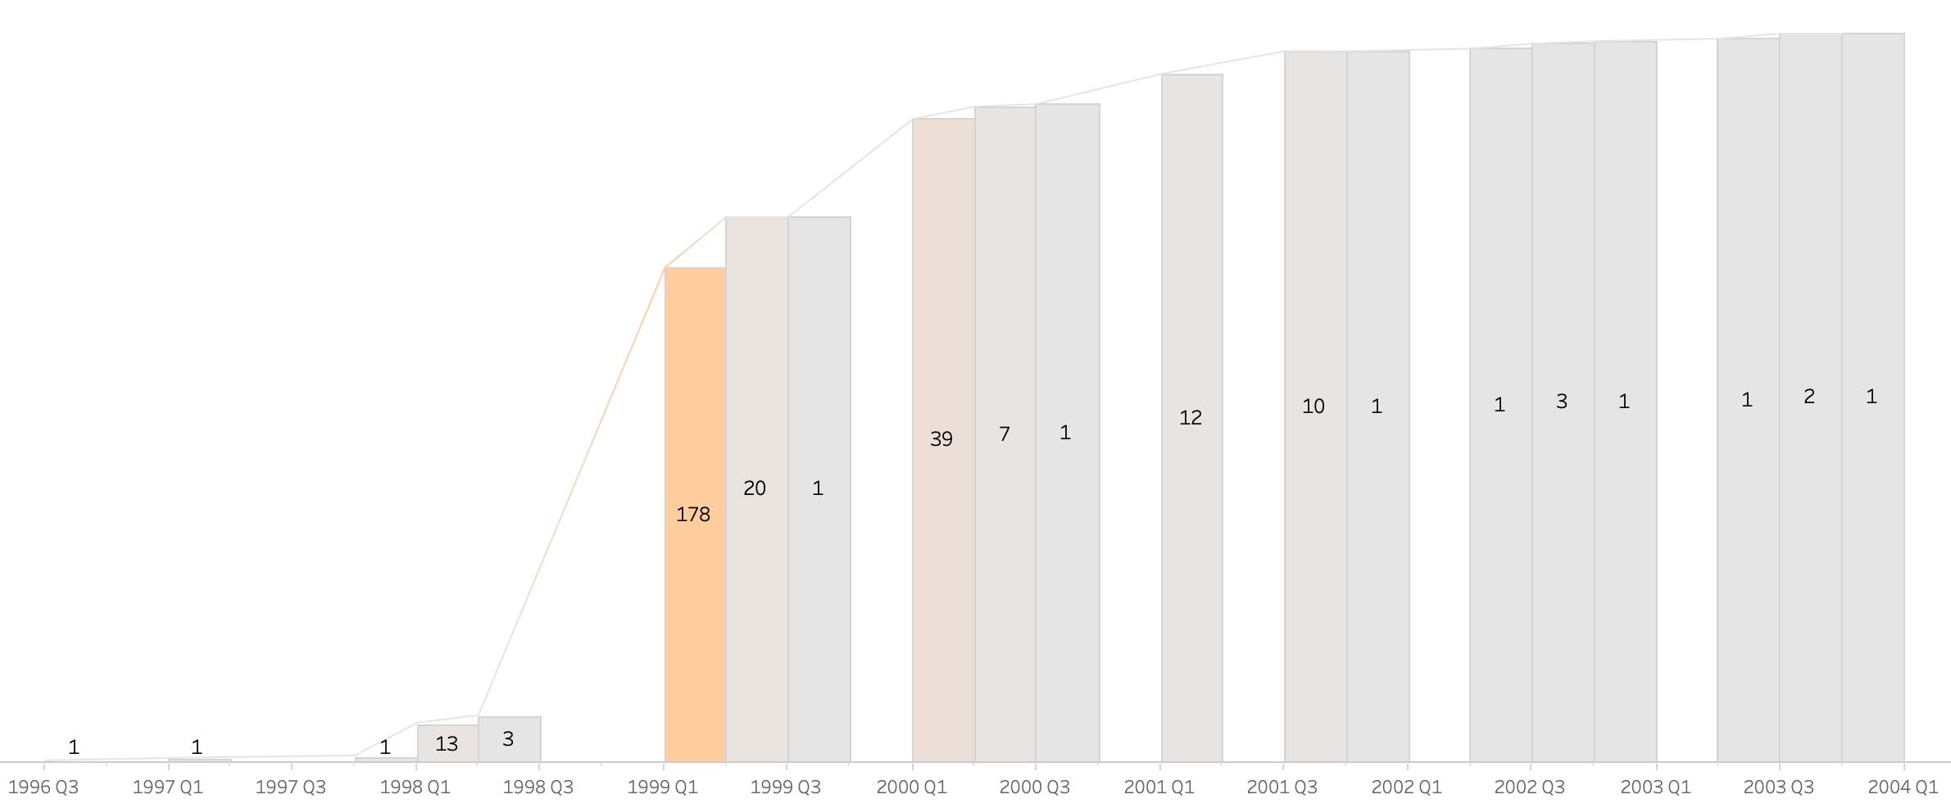
Headcount over time
We’re now at 290 employees
The company’s major headcount growth
Company’s work starts

Slide 6
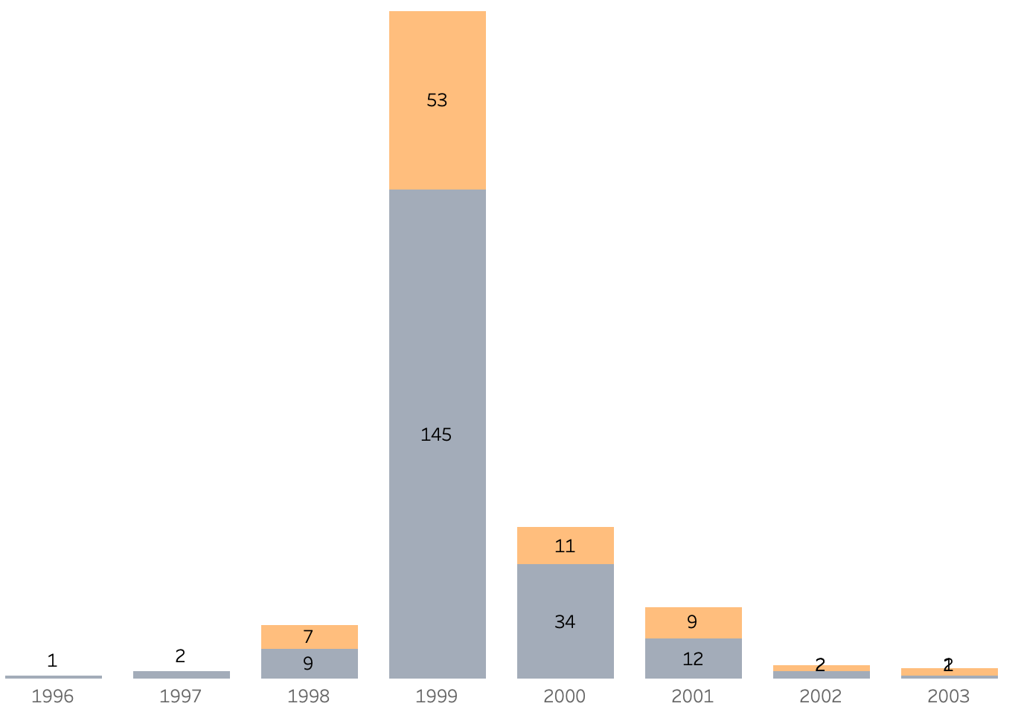
Hires Over time
The peak year of expanding our staff – 1999
with majority of hires in Production –
104 men and 34 women

Slide 7
Headcount over time
For the further analysis:
Analyze the promotion rates within the company
Implement training programs for the current employees’ qualifications
Create promotion reserve list
To check if the company’s decrease in staff expansion is the marker of overall business stagnation (match with sales analysis) and what’s value per employee in our business

Slide 8
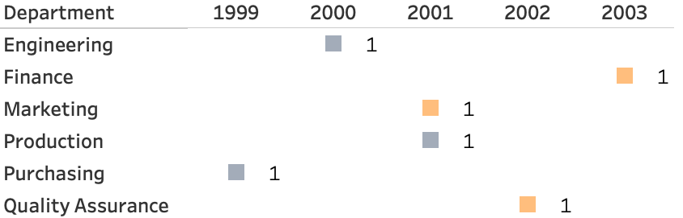
ATtRition

Slide 9
ATtRition
We should further:
Analyze the duration of employment
Check the causes of attrition
Implement employee work satisfaction surveys
Implement motivation/bonus system
Attrition is 2.1%
(in 8 years)
With 3 men and 3 women leaving the company

Slide 10
Gender ratio

Slide 11
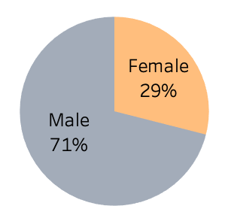
Gender Ratio
By 2004:
Men – 206
Women – 84

Slide 12
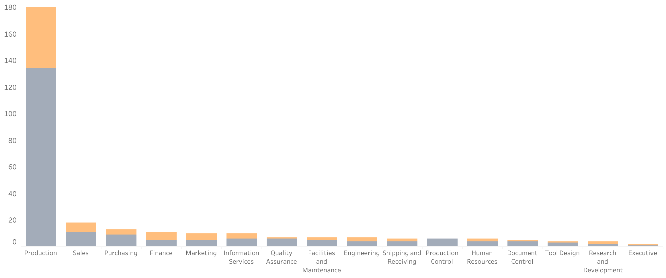
Gender in departments
We’ve got more male over female employees in our technical departments

Slide 13
Gender in departments
We should be more inclusive, meaning:
Maintaining equality – considering hiring both males and females based on their proficiency and skills to positions where physical abilities are not the major definitive
Maintaining safe space and work environment

Slide 14
Age groups

Slide 15
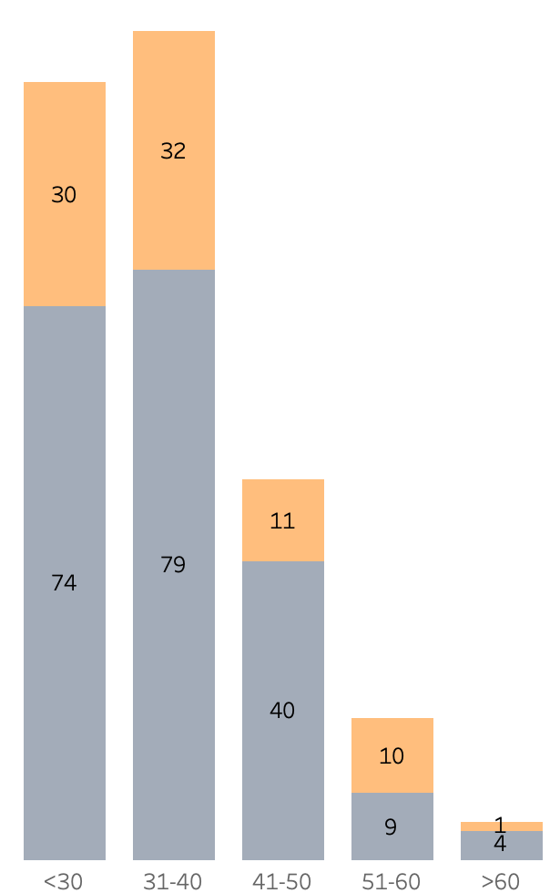
Age groups
We divide our headcount into 5 groups
The two major age groups are <30 and 31-40 that together make 74% of our headcount

Slide 16
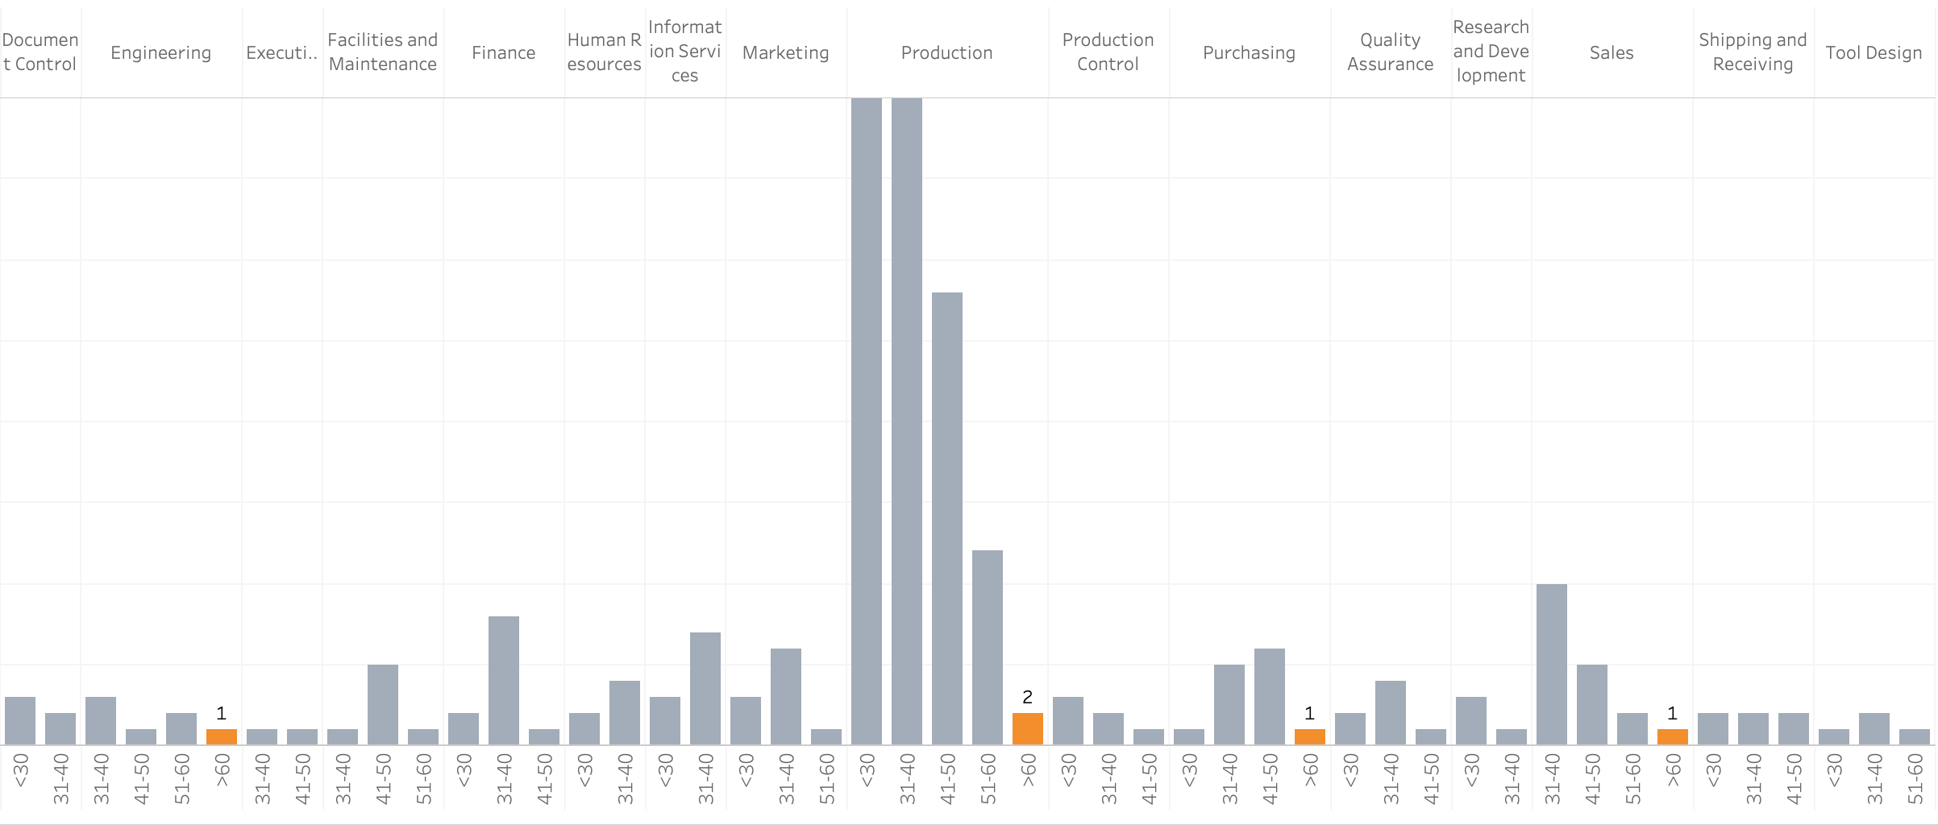
age groups in departments
Marked orange – number of employees getting closer to retirement age

Slide 17
age groups in departments
Suggestions for managing those employees getting closer to retirement age:
If performing hard physical labor – to ease their job responsibilities (to observing/supervising instead)
If getting too much stress and responsibilities – to spread the scope of work between several employees
If the employee has significant value and experience – to involve them into teaching process for less experienced colleagues

Slide 18
Shift planning

Slide 19
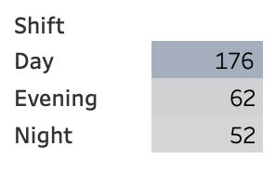
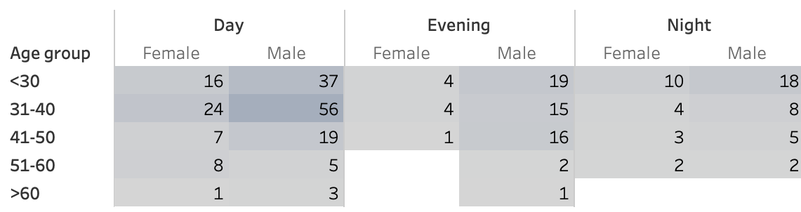
Age groups in shifts
Total number of employees on shift
Number of employees

Slide 20
Age groups in shifts
We should consider:
Evening/night shifts are causing more stress on body
With age people are tolerating stress worse
Suggestions would be:
Try to avoid putting those in the age groups over 50 to late hours shifts
Rearranging staff on shifts as nighttime rate is more expensive to the company (moving more to daytime if possible)

Slide 21
Rates and gender

Slide 22
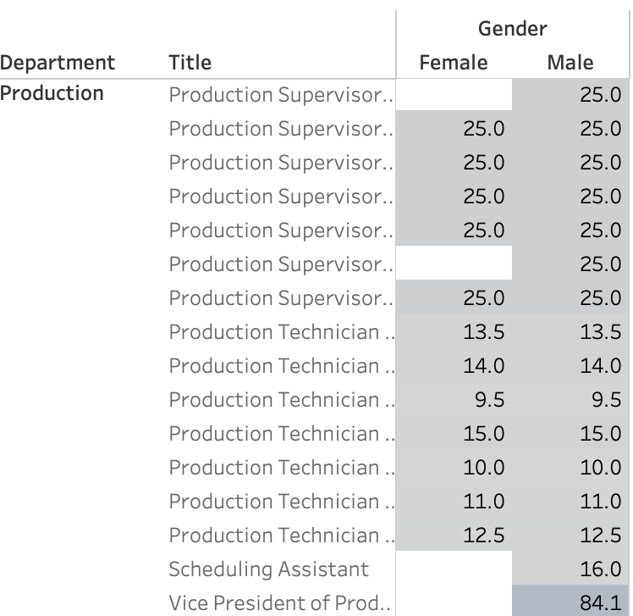
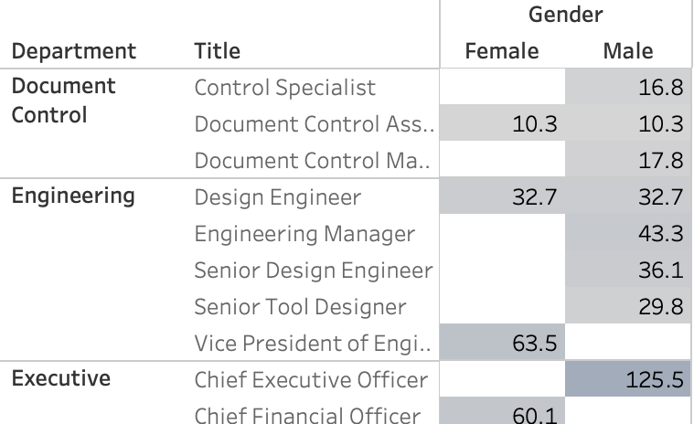
Rates and GEnder
Rate pay per hour ($)
We can see that people are paid equal rates, no matter their gender
This is shown in all of our departments
Rate pay per hour ($)

Slide 23
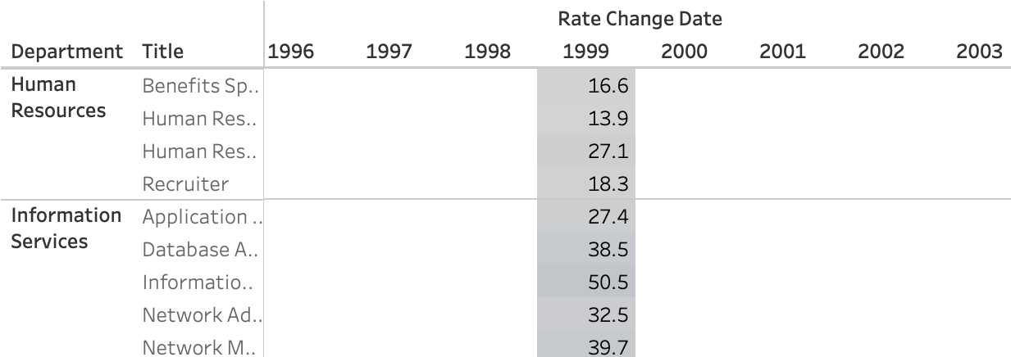
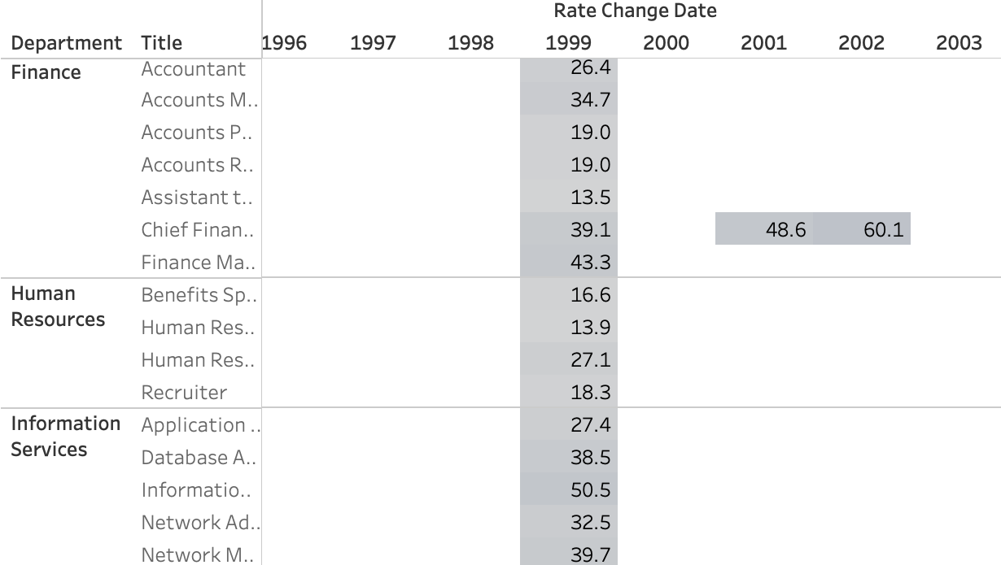
Rates change
However, for some positions the last rate change was over 4 years ago, that is something to analyze in the future
Rate pay per hour ($)

Slide 24
Possible new positions

Slide 25
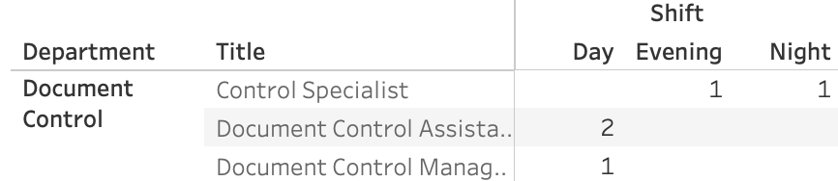
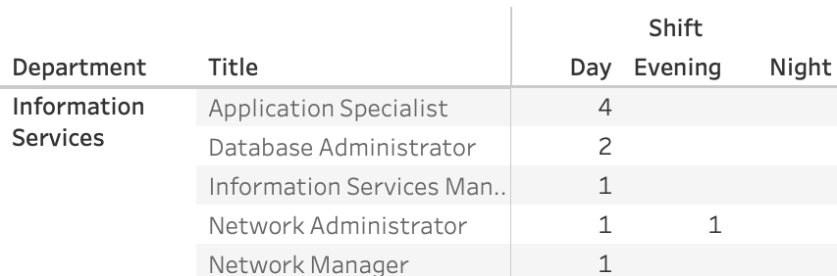
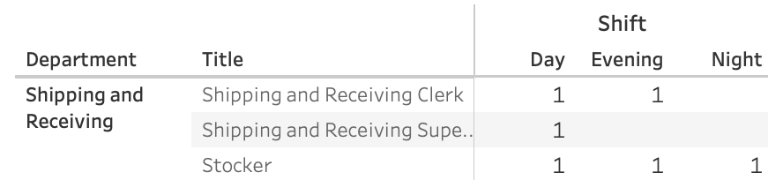
Possibility of new hires
Recommendation would be:
To consider hiring additional employees for the shifts that are not covered by current staff

Slide 26
To conclude
Our company has steady staff of 290 employees with attrition of 6 people in 8 years
Where 2/3 of our headcount is male and 1/3 - female employees
With 74% of our headcount in the age below 40
We keep rate pay equal to both gender employees

Slide 27
Recommendations
Create various training/motivation programs for current employees
Create promotion system within company
Maintain principles of gender equality and safe workspace
Implement recommended shift changes and new positions filled
Look into increases of rates when it’s been over 2 years since the last increase
Create loyalty bonus system

